Slide 1

Expense Tracker with Smart Overspending Alert
Theme- SDG 12 – Responsible Consumption
SDG 8 – Economic Growth
Category- Software/Hardware
Group No - 8
Group Members- • Soham Bhosale • Om Lad • Ojas Walke• Aryan Yadav
Guide- Prof. Taruna Sharma

Slide 2
Outline
Introduction
Literature Survey
Limitations of existing systems
Problem statement and Objectives
Proposed Methodology
Experimental Setup
Implementation
Results & Analysis
Conclusion and Future work
References

Slide 3
Introduction
Background
• Students often fail to track daily expenses.
• Budget planning is usually ignored.
• Money shortage occurs before month-end.
Importance of Problem
• Financial awareness is essential for students.
• Helps reduce impulsive purchases.
• Promotes responsible spending habits.
• Supports SDG goal of responsible consumption.

Slide 4
Current Challenges & Motivation
Current Challenges
• Manual expense tracking is inconvenient.
• Existing finance apps are complex.
• No prediction of future balance.
• Users do not know spending patterns.
Motivation
• Students face end-of-month financial crisis.
• Need simple, student-friendly solution.
• Help users survive within monthly budget.

Slide 5
Objectives of Project
• Enable simple expense logging.
• Categorize expenses automatically.
• Calculate daily spending rate.
• Predict money exhaustion date.
• Provide smart overspending alerts.
• Track savings goals progress.
• Improve spending discipline.

Slide 6
Literature Survey
Observations
• Existing apps focus only on record keeping.
• No focus on student survival budgeting.
• Lack of intelligent alerts & predictions.
System | Feature | Limitation
Expense Manager Apps | Expense recording | No prediction
Banking Apps | Transaction logs | No budgeting
Wallet Apps | Reports | Complex UI

Slide 7
Limitations of existing Systems
• No future balance prediction.
• No intelligent spending alerts.
• No savings goal impact analysis.
• Complex financial dashboards.
• Manual data entry required.
• No student-focused financial planning.
• Limited behavioral spending insights.

Slide 8
Problem statement and Objectives
Problem Statement
Students lack a simple system to monitor expenses and predict future financial survival based on current spending patterns.
Objectives Addressed
• Track expenses in real time.
• Analyze spending patterns.
• Predict survival days.
• Support savings goal planning.

Slide 9
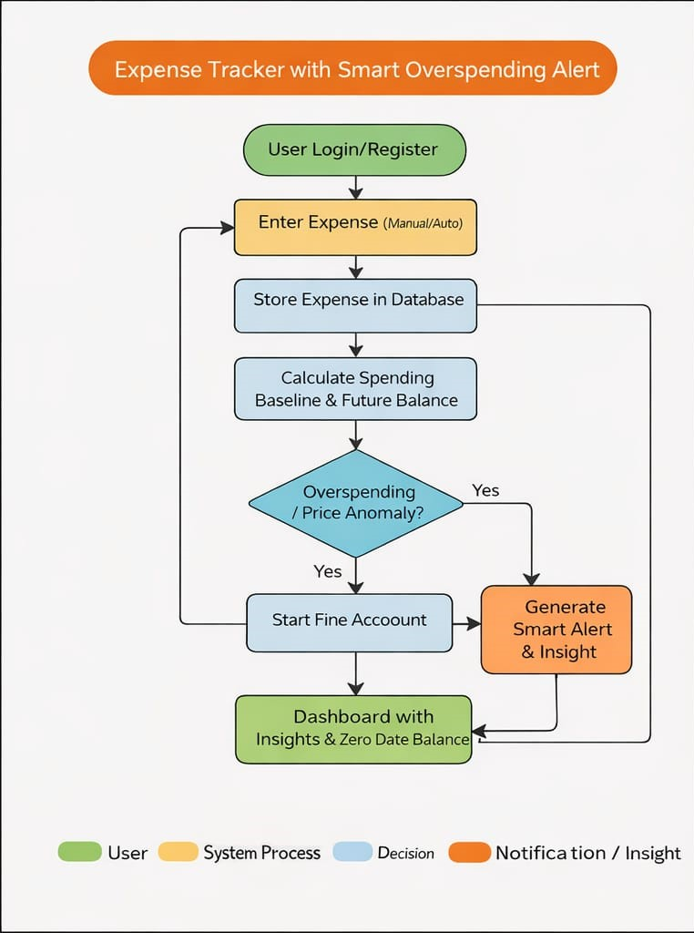
Proposed Methodology
System Modules
• Expense Input Module
• Category Classification
• Firebase Database Storage
• Spending Analysis Engine
• Prediction Engine
• Dashboard Visualization
• Goal Tracking Module

Slide 10
Experimental Setup
Software Technologies
• React Js and React Native frontend
• Firebase Firestore database
• Firebase authentication
• Chart.js for visualization
Tools Used
• VS Code editor
• Firebase console
• Browser testing tools
Input Data
• User expense records
• Bank & cash balance inputs

Slide 11
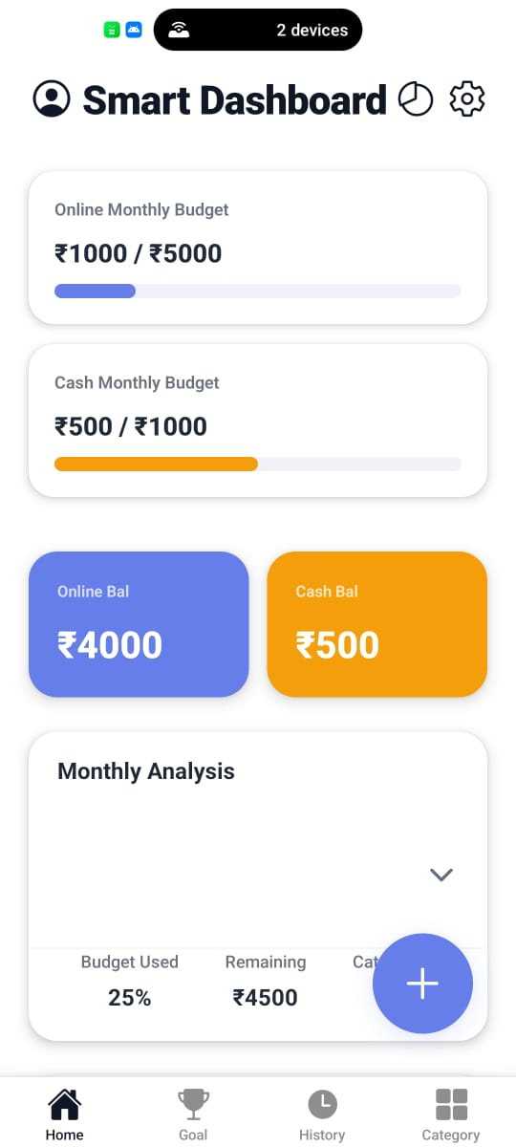
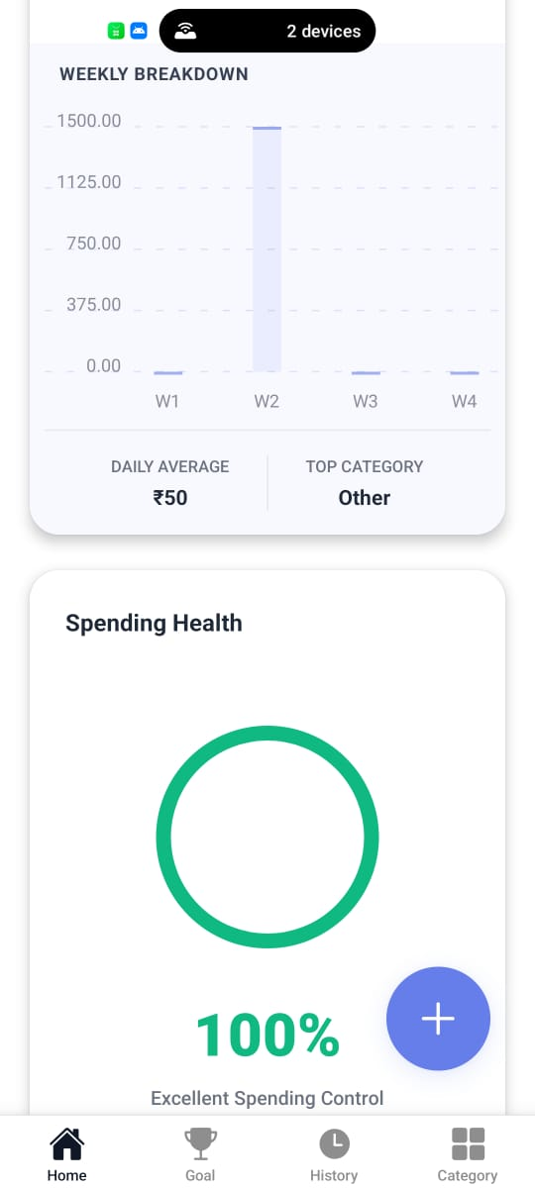
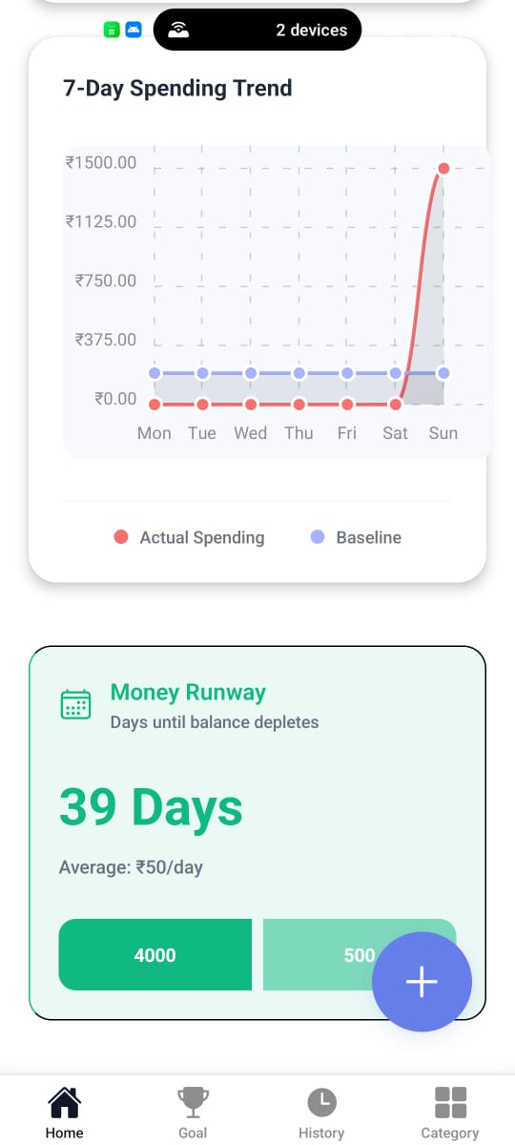
Implementation
Dashboard

Slide 12
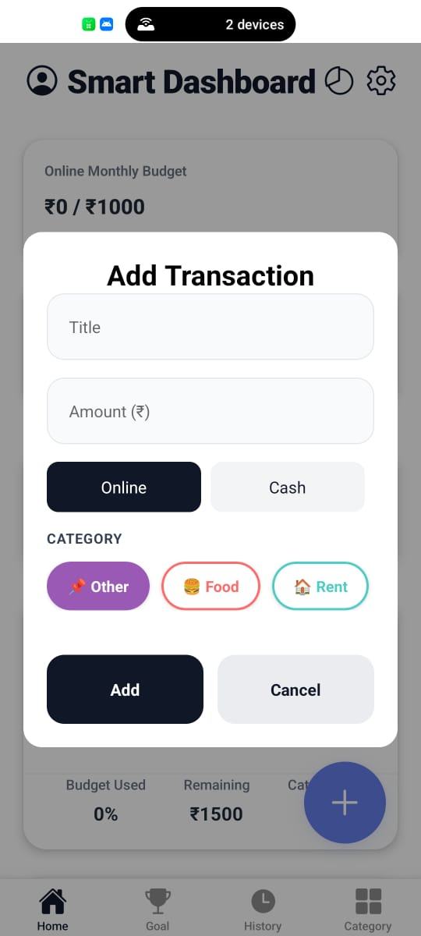
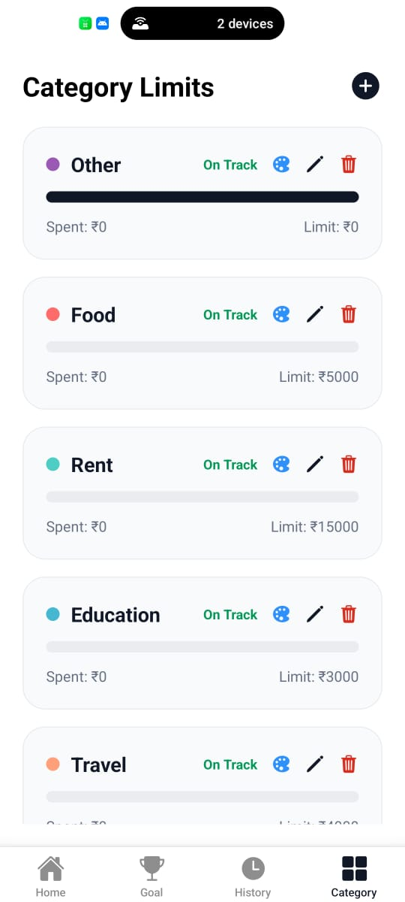
Implementation
Categories
Add Transaction

Slide 13
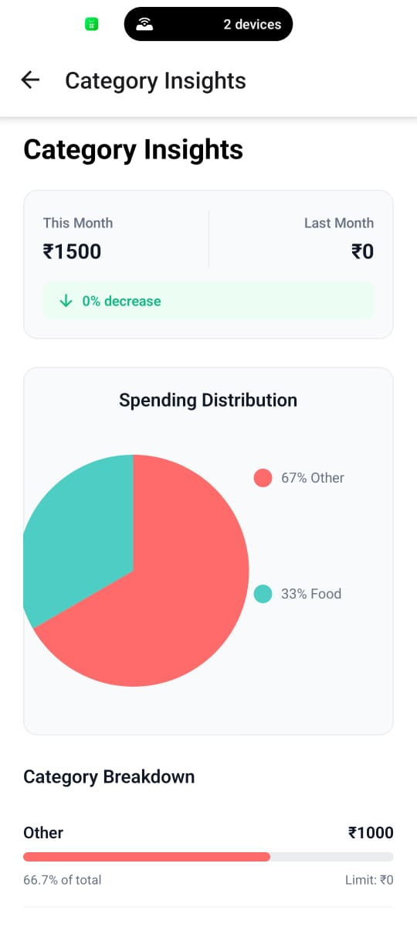
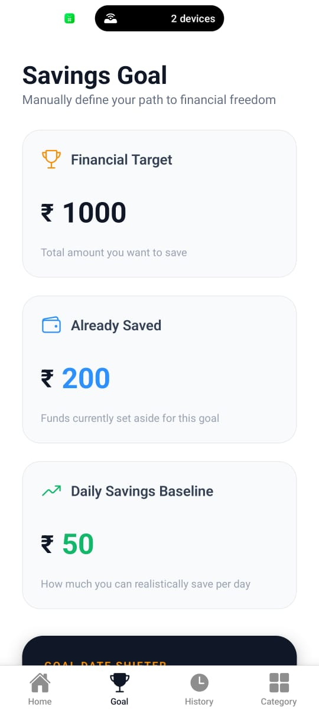
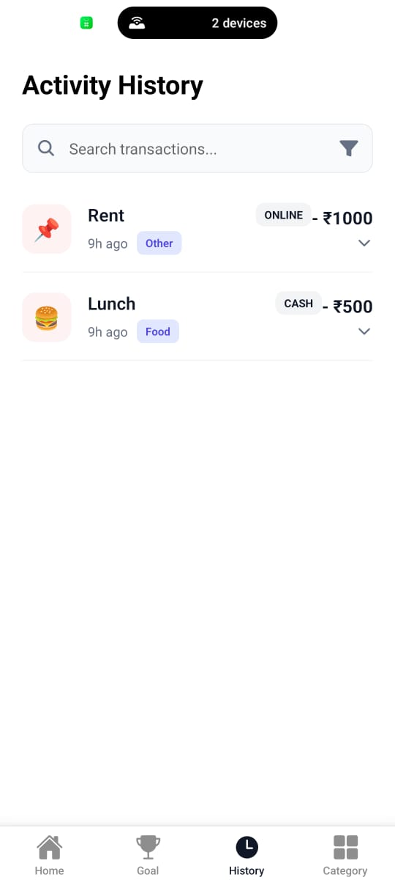
Implementation

Slide 14
Results & Analysis
Observed Results
• Accurate daily burn rate calculated.
• Future balance prediction working.
• Spending trends visualized clearly.
Impact
• Users become aware of spending habits.
• Helps reduce impulsive expenses.
• Encourages savings behavior.

Slide 15
Conclusion
Outcomes
• Expense tracking simplified.
• Future survival prediction achieved.
• Smart alerts improve spending discipline.
• Student-friendly financial tool created.
Objectives Achieved
• Expense logging
• Spending analysis
• Budget prediction

Slide 16
Future Work
Improvements Planned
• Automatic bank SMS transaction capture.
• Mobile app development.
• AI-based spending advice.
• Monthly budget recommendations.
• Notification alerts for overspending.
• Advanced goal prediction.

Slide 17
References
A. Saraboji and S. Lakshmi, “Expense Tracker Application,” International Advanced Research Journal in Science, Engineering and Technology, vol. 11, no. 6, 2024. https://iarjset.com/papers/expense-tracker-application/
J. Jasmine, R. EM, R. Paruthiya, P. Pranesh and Kalandhar, “Expense Tracker App,” International Journal for Research in Applied Science and Engineering Technology (IJRASET), 2024. https://doi.org/10.22214/ijraset.2024.58795
R. Shirke, A. Sabde, P. Swami and R. Chavan, “Budget Buddy: An AI-Powered Personal Finance Management System,” International Journal of Scientific Innovation in Engineering, vol. 2, no. 11, 2025.
Available: https://ijsci.com/index.php/home/article/view/852
B. Mahto et al., “Smart Pocket: A Machine Learning-Based Expense Tracker and Spending Predictor,” International Journal of Research and Innovation in Applied Science, vol. 10, no. 11, 2025.
Available: https://rsisinternational.org/journals/ijrias/view/smart-pocket-a-machine-learning-based-expense-tracker-and-spending-predictor
R. S. Birajdar, “Personal Expense Tracker: Advancing Financial Management through Software Solutions,” International Multidisciplinary Research Journal, vol. 2, 2025.
Available: https://iipublications.com/iipimrj/article/view/10

Slide 18
Thank You...!!

